Slide 1
Biological Modeling of Neural Networks:
Week 10 – part 1 : Neuronal Populations
10.1 Cortical Populations
- columns and receptive fields
10.2 Connectivity
- cortical connectivity
- model connectivity schemes
10.3 Mean-field argument
- asynchronous state
10.4 Random Networks
- Balanced state
Week 10 – Neuronal Populations
Wulfram Gerstner
EPFL, Lausanne, Switzerland
Notes:
Lecture 10:
-45 minutes to get to slide 32: 1st lecture finished with asynchrounous state on blackboard.

Slide 2
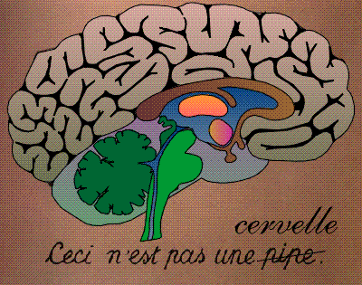
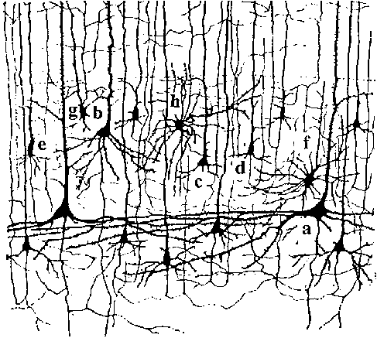
Biological Modeling of Neural Networks – Review from week 1
10 000 neurons
3 km wire
motor
cortex
1mm
frontal
cortex
to motor
output

Slide 3
Biological Modeling of Neural Networks – Review from week 7
population of neurons
with similar properties
neuron 1
neuron 2
Neuron K
Brain
stim

Slide 4
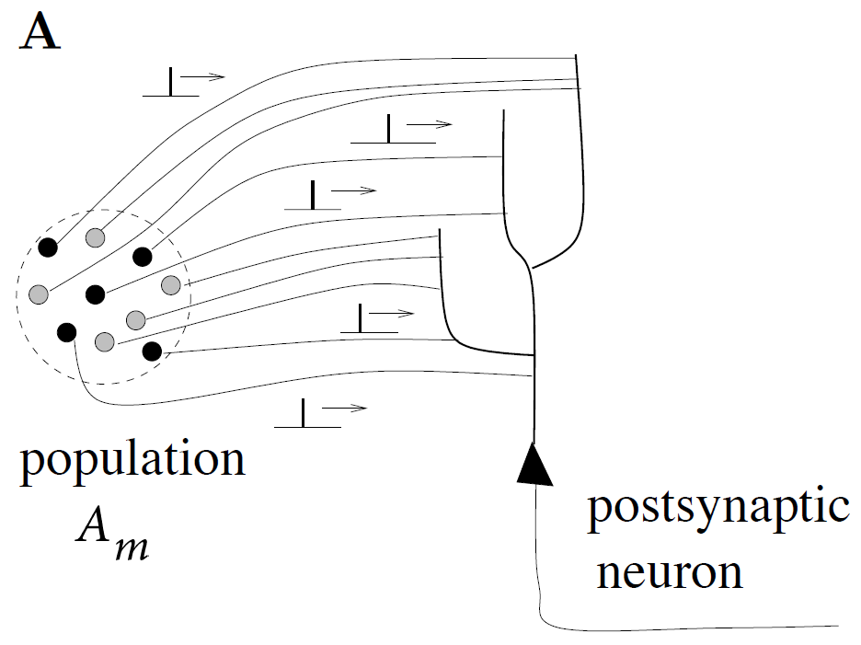
Biological Modeling of Neural Networks – Review from week 7
population activity - rate defined by population average
t
t
‘natural readout’
population
activity

Slide 5
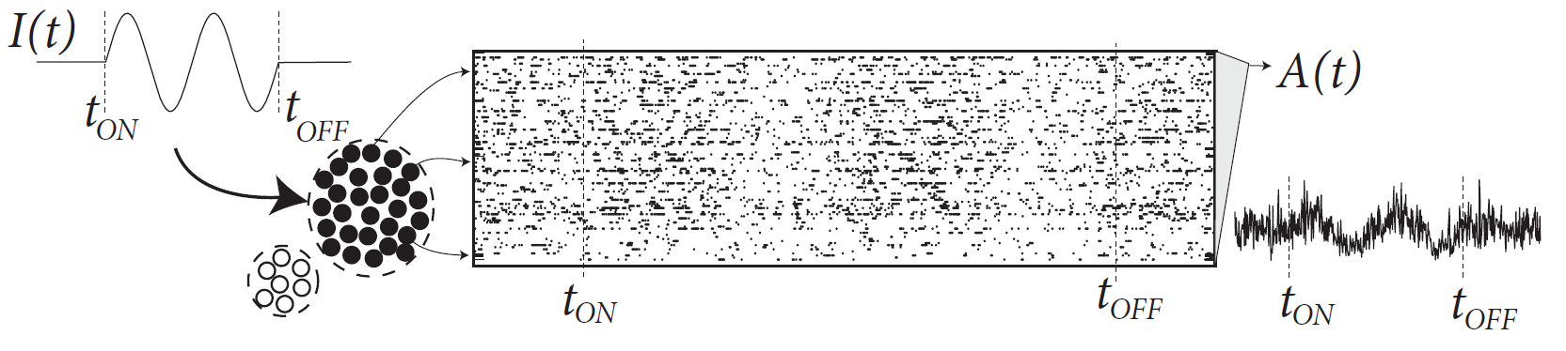
Week 10-part 1: Population activity
population of neurons
with similar properties
Brain

Slide 6
Week 10-part 1: Population activity
population of neurons
with similar properties
population activity
A(t)
Are there such populations?
Brain

Slide 7
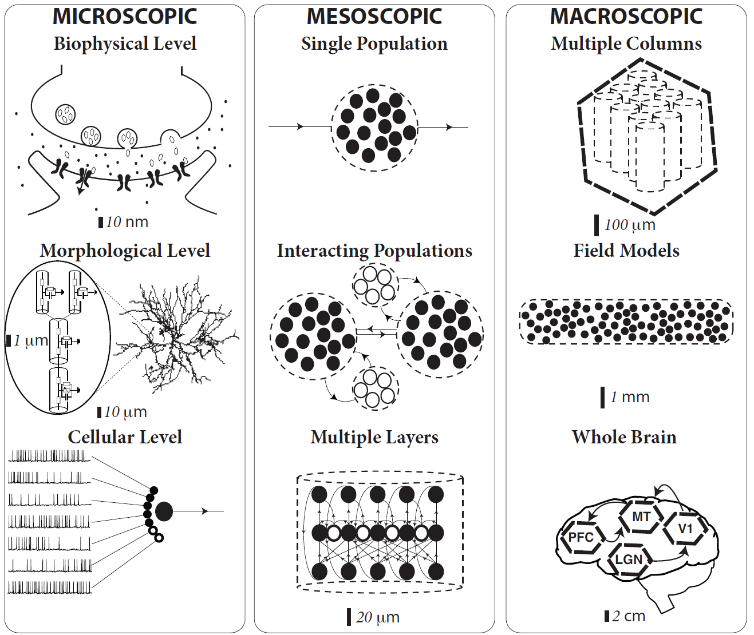
Week 10-part 1: Scales of neuronal processes
population of neurons
with similar properties
Brain

Slide 8
Biological Modeling of Neural Networks:
Week 10 – part 1b :Cortical Populations – columns and receptive fields
10.1 Cortical Populations
- columns and receptive fields
10.2 Connectivity
- cortical connectivity
- model connectivity schemes
10.3 Mean-field argument
- asynchronous state
10.4 Random networks
Week 10 – Neuronal Populations
Wulfram Gerstner
EPFL, Lausanne, Switzerland
Notes:
Lecture 10:

Slide 9
Week 10-part 1b: Receptive fields
visual
cortex
electrode

Slide 10
Week 10-part 1b: Receptive fields
visual
cortex
electrode

Slide 11
Week 10-part 1b: Receptive fields and retinotopic map
visual
cortex
Neighboring cells
in visual cortex
have similar preferred
center of receptive field

Slide 12
Week 10-part 1b: Orientation tuning of receptive fields
Receptive fields:
Retina, LGN
Receptive fields:
visual cortex V1
Orientation selective

Slide 13
Week 10-part 1b: Orientation tuning of receptive fields
Receptive fields:
visual cortex V1
Orientation selective

Slide 14
Week 10-part 1b: Orientation tuning of receptive fields
Receptive fields:
visual cortex V1
preferred orientation
rate
0
Orientation selective
Stimulus orientation

Slide 15
Week 10-part 1b: Orientation columns/orientation maps
Receptive fields:
visual cortex V1
visual
cortex
1st pop
2nd pop
2nd pop
Neighboring neurons have similar properties
Orientation selective

Slide 16
Week 10-part 1b: Orientation map
visual
cortex
Neighboring cells in visual cortex
Have similar preferred orientation:
cortical orientation map

Slide 17
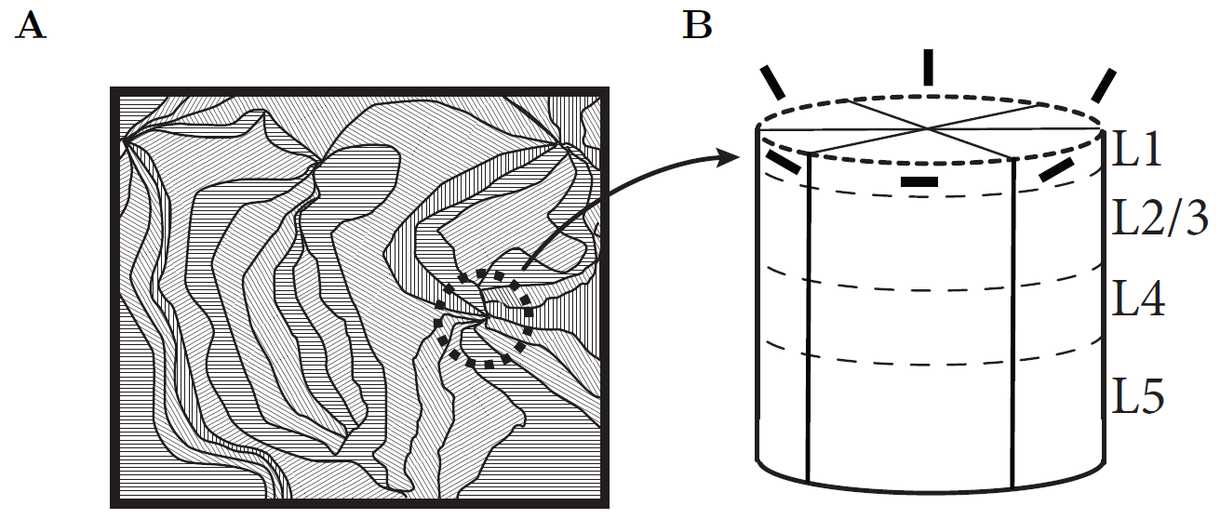
Week 10-part 1b: Orientation columns/orientation maps
population of neighboring neurons: different orientations
Image: Gerstner et al.
Neuronal Dynamics (2014)
Visual cortex

Slide 18
Week 10-part 1b: Interaction between populations / columns
I(t)

Slide 19
Week 10-part 1b: Do populations / columns really exist?
rate
Cell 1
0
Stimulus orientation

Slide 20
Week 10-part 1b: Do populations / columns really exist?
Course coding
rate
Cell 1
Cell 5
Many cells
(from different columns)
respond to a single
stimulus with different rate
0
Oriented stimulus

Slide 21
Quiz 1, now
The receptive field of a visual neuron refers to
[ ] The localized region of space to which it is sensitive
[ ] The orientation of a light bar to which it is sensitive
[ ] The set of all stimulus features to which it is sensitive
The receptive field of a auditory neuron refers to
[ ] The set of all stimulus features to which it is sensitive
[ ] The range of frequencies to which it is sensitive
The receptive field of a somatosensory neuron refers to
[ ] The set of all stimulus features to which it is sensitive
[ ] The region of body surface to which it is sensitive

Slide 22
Biological Modeling of Neural Networks:
Week 10 – part 2 : Connectivity
10.1 Cortical Populations
- columns and receptive fields
10.2 Connectivity
- cortical connectivity
- model connectivity schemes
10.3 Mean-field argument
- asynchronous state
10.4 Balanced state
Week 10 – Neuronal Populations
Wulfram Gerstner
EPFL, Lausanne, Switzerland
Notes:
Lecture 10:

Slide 23
Week 10-part 2: Connectivity schemes (models)
I(t)
1 population =
What?

Slide 24
Week 10-part 2: model population
population = group of neurons
with
- similar neuronal properties
- similar input
- similar receptive field
- similar connectivity
make this more precise

Slide 25
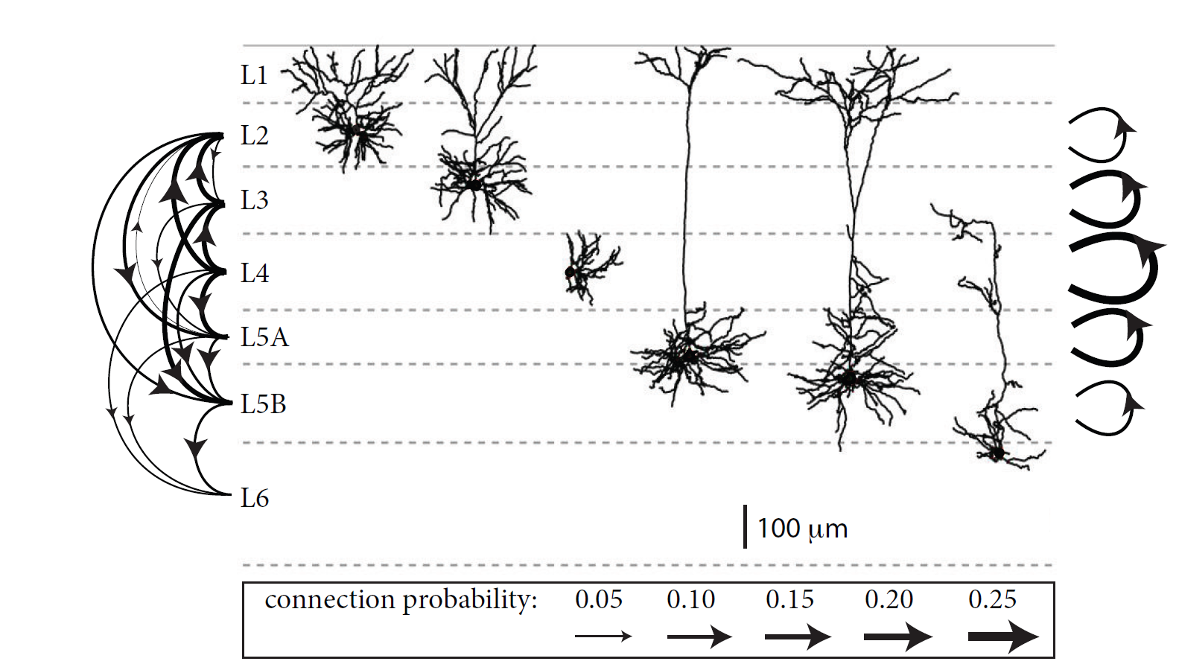
Week 10-part 2: local cortical connectivity across layers
(mouse somatosensory cortex)
Here:
Excitatory neurons
1 population =
all neurons of given type
in one layer of same column
(e.g. excitatory in layer 3)
Lefort et al. NEURON, 2009

Slide 26
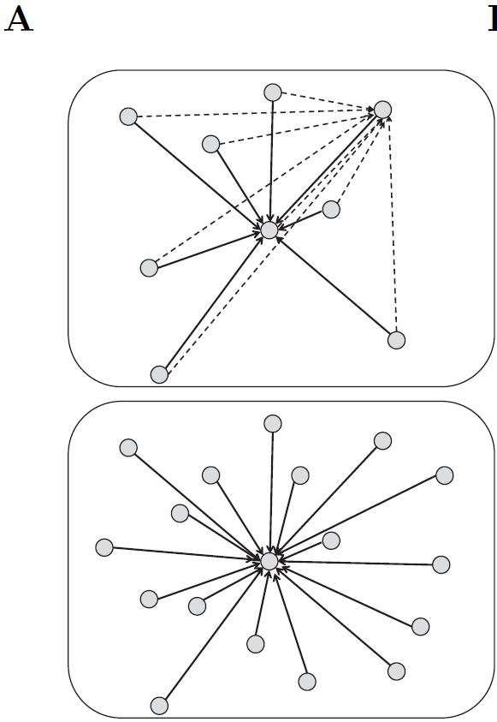
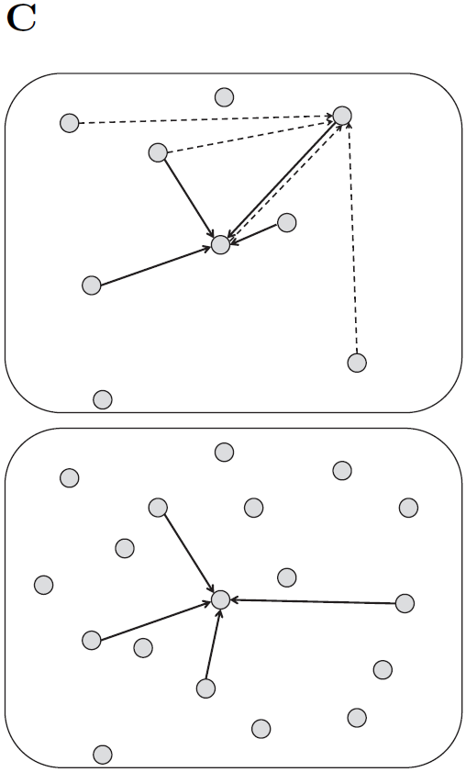
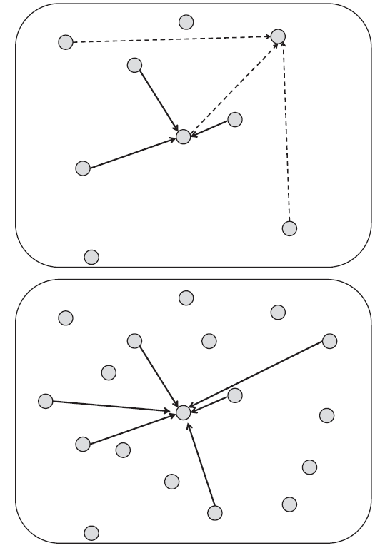
Week 10-part 2: Connectivity schemes (models)
full connectivity
random: prob p fixed
random: number K
of inputs fixed
Image: Gerstner et al.
Neuronal Dynamics (2014)

Slide 27
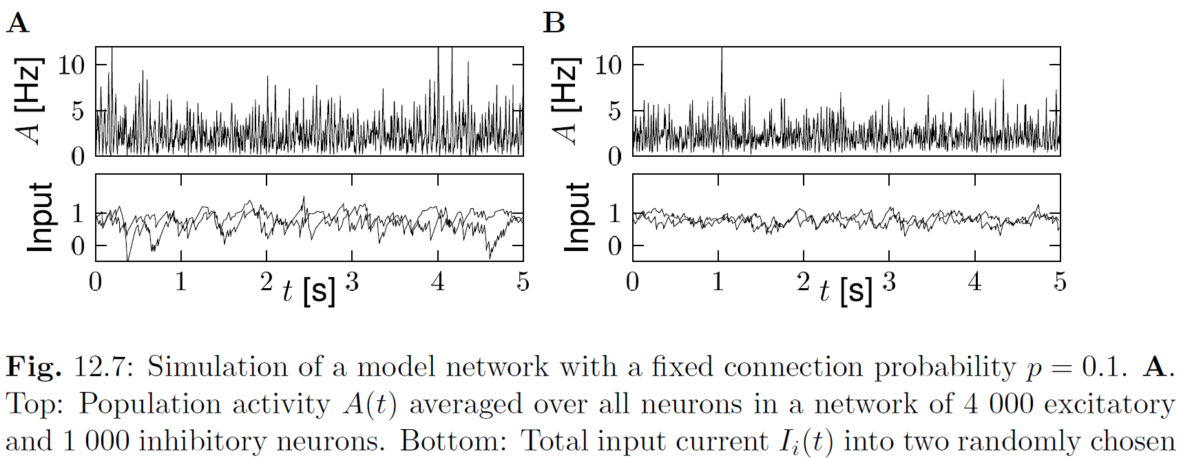
Week 10-part 2: Random Connectivity: fixed p
random: probability p=0.1, fixed
Image: Gerstner et al.
Neuronal Dynamics (2014)

Slide 28
Week 10-part 2: Random Connectivity: fixed p
Can we mathematically predict
the population activity?
given
- connection probability p
- properties of individual neurons
- large population
asynchronous
activity

Slide 29
Biological Modeling of Neural Networks:
Week 10 – part 2 : Connectivity
10.1 Cortical Populations
- columns and receptive fields
10.2 Connectivity
- cortical connectivity
- model connectivity schemes
10.3 Mean-field argument
- asynchronous state
10.4 Balanced state
Week 10 – Neuronal Populations
Wulfram Gerstner
EPFL, Lausanne, Switzerland
Notes:
Lecture 10:

Slide 30
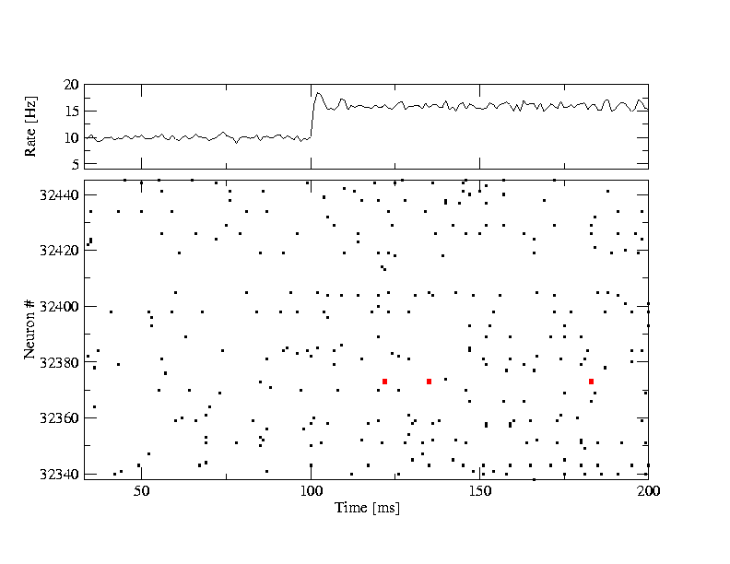
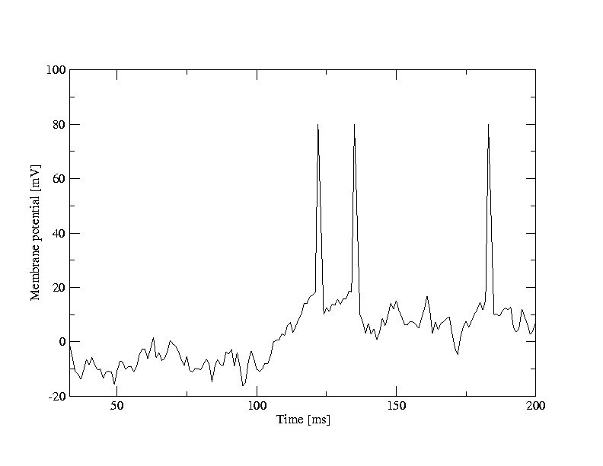
Random firing in a populations of neurons
A [Hz]
10
32440
Neuron #
input
-low rate
-high rate
32340
time [ms]
200
50
100
100
Neuron # 32374
u [mV]
Population
- 50 000 neurons
- 20 percent inhibitory
- randomly connected
0
50
100
time [ms]
200

Slide 31
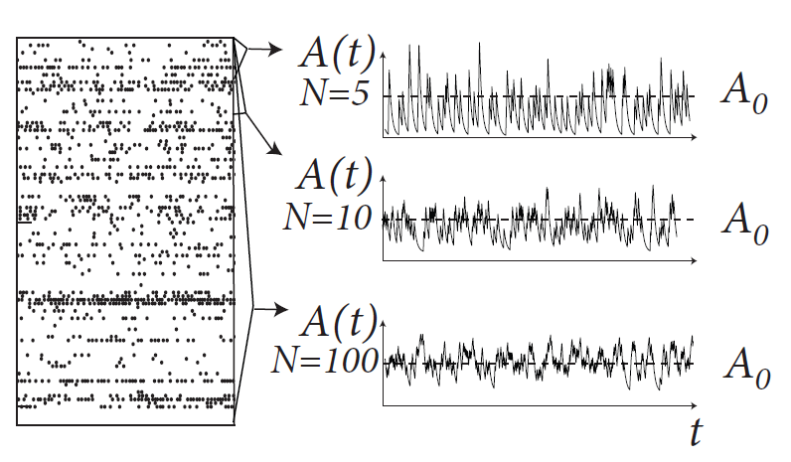
Week 10-part 3: asynchronous firing
Blackboard:
Definition of A(t)
filtered A(t)
<A(t)>
Asynchronous state
<A(t)> = A0= constant
Image: Gerstner et al.
Neuronal Dynamics (2014)

Slide 32
Week 10-part 3: counter-example: A(t) not constant
population of neurons
with similar properties
Systematic oscillation
→ not ‘asynchronous’
Brain
Notes:
At the end of 45 minutes, I was here.

Slide 33
Populations of spiking neurons
t
?
I(t)
population activity?
Homogeneous network:
each neuron receives input
from k neurons in network
-each neuron receives the same
(mean) external input
t
population
activity

Slide 34
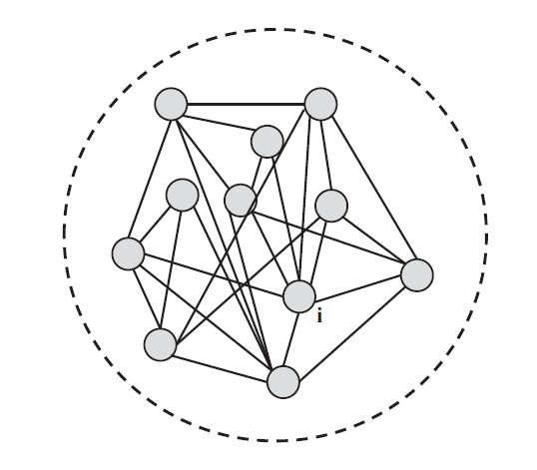
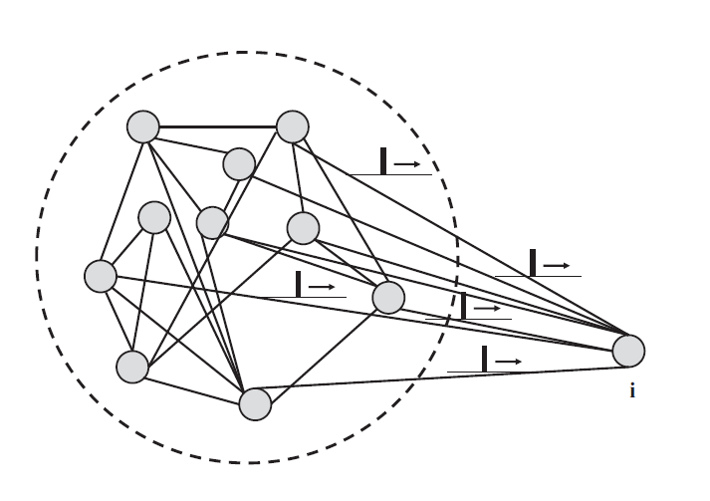
Week 10-part 3: mean-field arguments
Blackboard:
Input to neuron i

Slide 35
Week 10-part 3: mean-field arguments
Full connectivity

Slide 36
Week 10-part 3: mean-field arguments
Fully connected network
blackboard
fully
connected
N >> 1
All spikes, all neurons
Synaptic coupling

Slide 37
Week 10-part 3: mean-field arguments
All neurons receive the same total input current
(‘mean field’)
fully
connected
Index i disappears
All spikes, all neurons

Slide 38
Week 10-part 3: stationary state/asynchronous activity
Homogeneous network
All neurons are identical,
Single neuron rate = population rate
A(t)= A0= const
Single neuron
blackboard
frequency (single neuron)

Slide 39
Stationary solution
fully
connected
N >> 1
Homogeneous network, stationary,
All neurons are identical,
Single neuron rate = population rate

Slide 40
Exercise 1, now
Next lecture:
11h15
Exercise 1: homogeneous stationary solution
fully
connected
N >> 1
Homogeneous network
All neurons are identical,
Single neuron rate = population rate

Slide 41
Single Population
- population activity, definition
- full connectivity
- stationary state/asynchronous state
Single neuron rate = population rate
What is this function g?
Examples: - leaky integrate-and-fire with diffusive noise
- Spike Response Model with escape noise
- Hodgkin-Huxley model (see week 2)

Slide 42
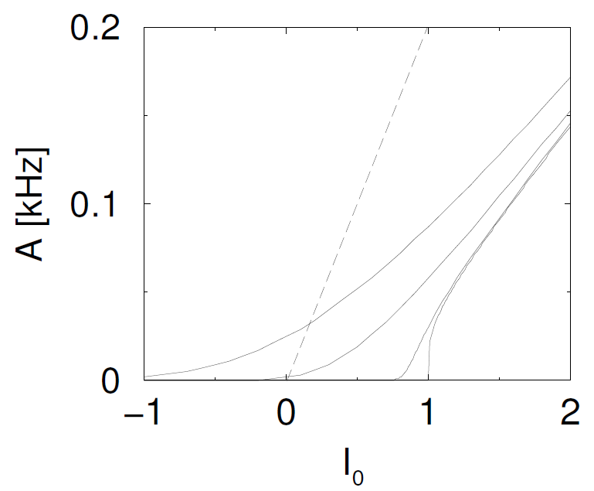
Week 10-part 3: mean-field, leaky integrate-and-fire
different noise levels
function g can be calculated

Slide 43
Review: Spike Response Model with Escape Noise
Spike emission
j
i
Spike reception: EPSP
Spike emission: AP
Last spike of i
All spikes, all neurons
Firing intensity

Slide 44
Review: Spike Response Model with Escape Noise
Spike emission: AP
Response to current pulse
potential
Blackboard
Renewal model
Interval distrib.
Last spike of i
external input
potential
Last spike of i
input potential
instantaneous rate

Slide 45
Week 10-part 3: Example - Asynchronous state in SRM0
Homogeneous network
All neurons are identical,
Single neuron rate = population rate
A(t)= A0= const
Single neuron
frequency (single neuron)

Slide 46
Week 10-part 3: Example - Asynchronous state in SRM0
input potential
A(t)=const
fully connected
typical mean field
(Curie Weiss)
Homogeneous network
All neurons are identical,
frequency (single neuron)

Slide 47
Biological Modeling of Neural Networks:
Week 10 – part 4 : Random networks
10.1 Cortical Populations
- columns and receptive fields
10.2 Connectivity
- cortical connectivity
- model connectivity schemes
10.3 Mean-field argument
- asynchronous state
10.4 Random networks
- balanced state
Week 10 – Neuronal Populations
Wulfram Gerstner
EPFL, Lausanne, Switzerland
Notes:
Lecture 10:

Slide 48
Week 10-part 4: mean-field arguments – random connectivity
random connectivity
full connectivity
random: prob p fixed
random: number K
of inputs fixed
Image: Gerstner et al.
Neuronal Dynamics (2014)

Slide 49
Week 10-part 4: mean-field arguments – random connectivity
Blackboard:
excit. – inhib.
I&F with diffusive noise
(stochastic spike arrival)
For any arbitrary neuron in the population
EPSC
IPSC
excitatory input spikes

Slide 50
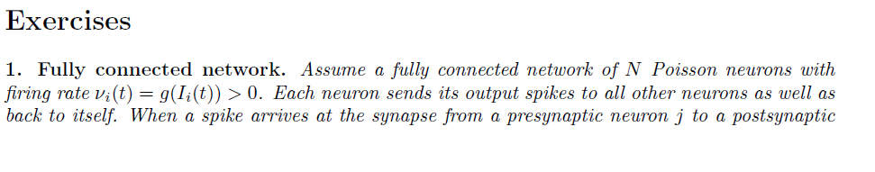
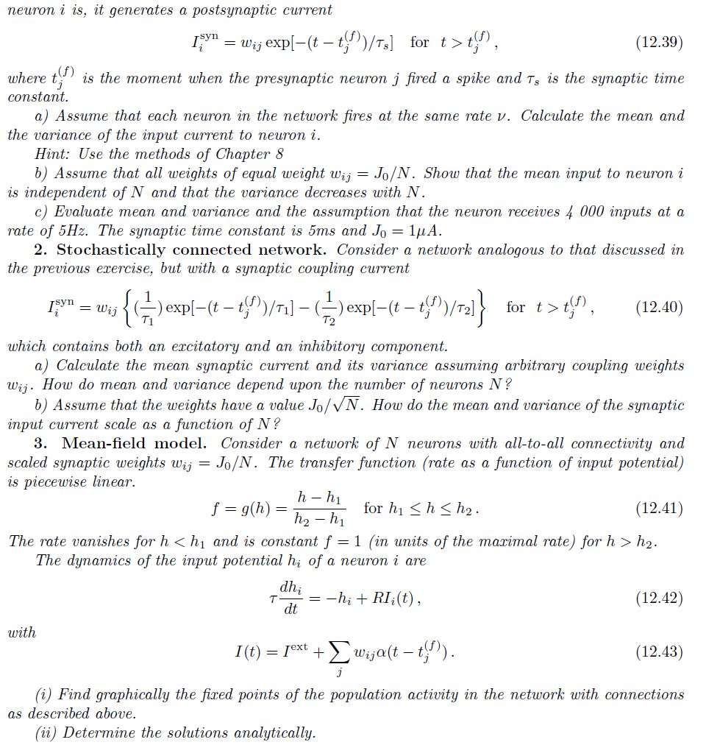
Week 10-Exercise 2.1/2.2 now: Poisson/random network
Next lecture:
11h40
2.
random: prob p fixed
3.

Slide 51
Week 10-part 4: Random Connectivity: fixed p
random: probability p=0.1, fixed
Network N=5 000
Network N=10 000
Image: Gerstner et al.
Neuronal Dynamics (2014)
fluctations of A decrease
fluctations of I decrease

Slide 52
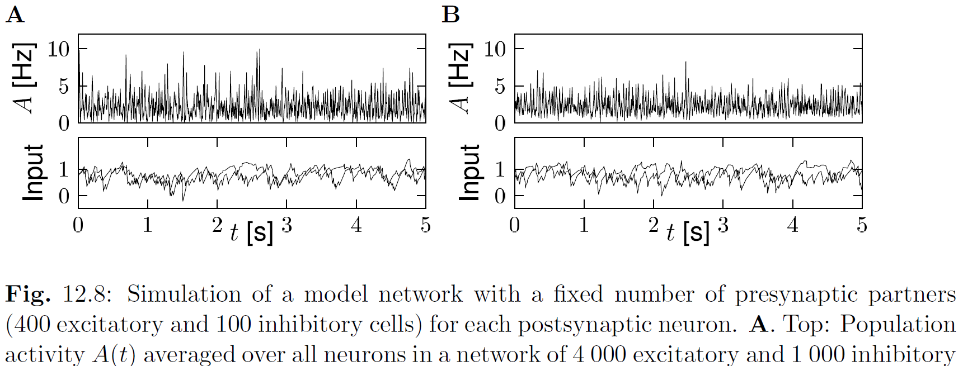
Week 10-part 4: Random connectivity – fixed number of inputs
random: number of inputs K=500, fixed
Network N=5 000
Network N=10 000
Image: Gerstner et al.
Neuronal Dynamics (2014)
fluctations of A decrease
fluctations of I remain

Slide 53
Week 10-part 4: Connectivity schemes – fixed p, but balanced
inh
exc
make network bigger, but
keep mean input close to zero
keep variance of input

Slide 54
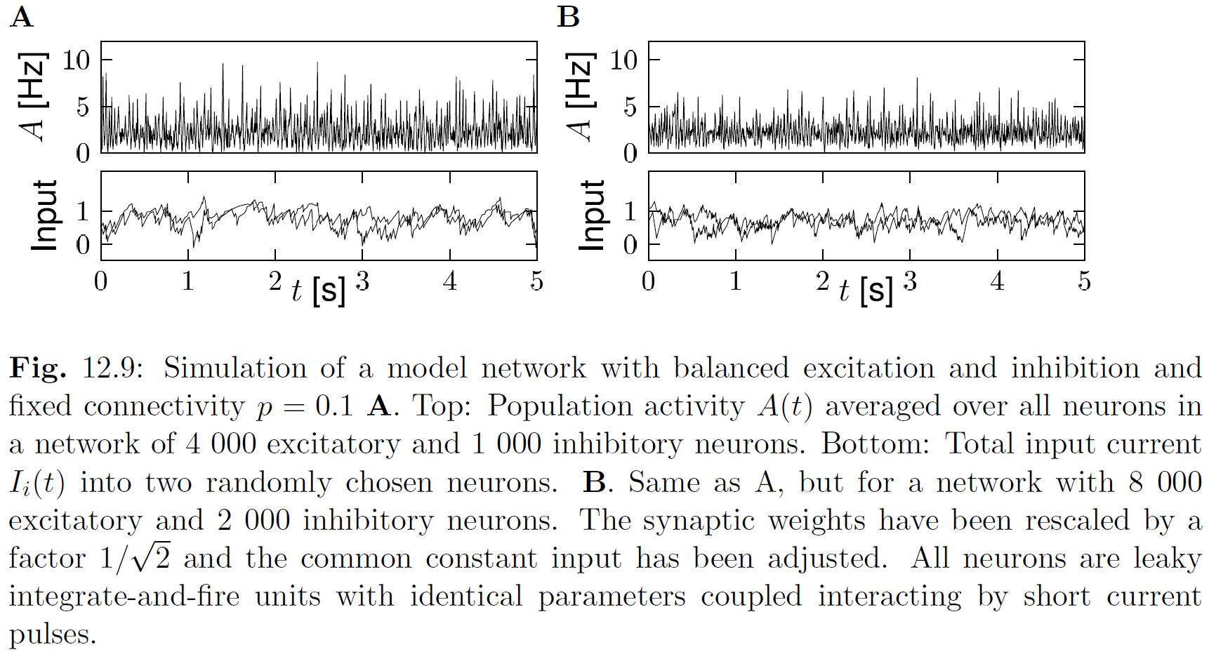
Week 10-part 4: Connectivity schemes - balanced
Image: Gerstner et al.
Neuronal Dynamics (2014)
fluctations of A decrease
fluctations of I decrease, but ‘smooth’

Slide 55
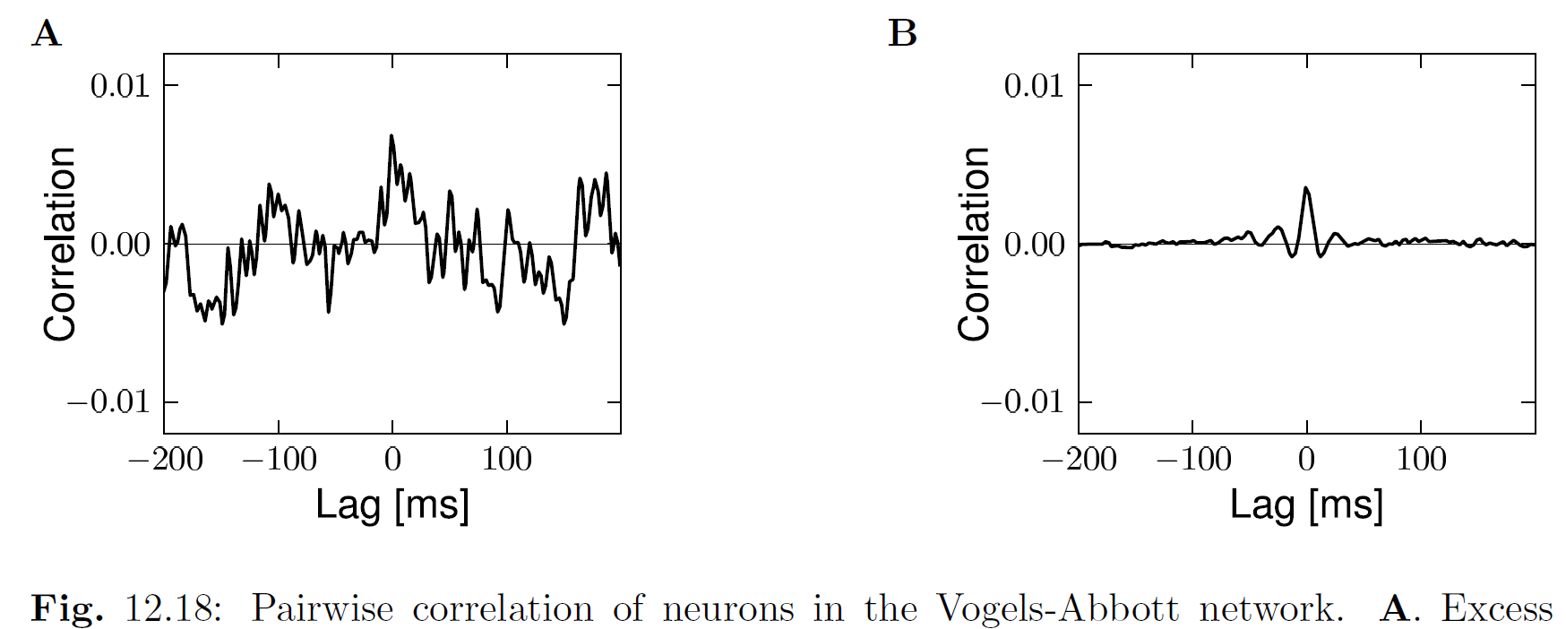
Week 10-part 4: leaky integrate-and-fire, balanced random network
Network with balanced excitation-inhibition
- 10 000 neurons
- 20 percent inhibitory
- randomly connected
Image: Gerstner et al.
Neuronal Dynamics (2014)

Slide 56
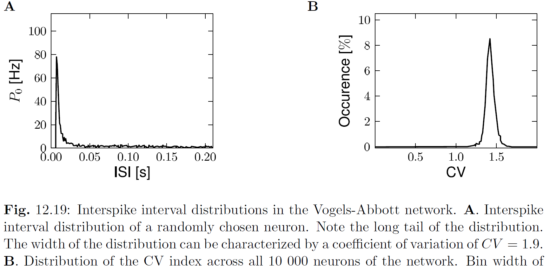
Week 10-part 4: leaky integrate-and-fire, balanced random network
Image: Gerstner et al.
Neuronal Dynamics (2014)

Slide 57
Week 10 – Introduction to Neuronal Populations
10.1 Cortical Populations
- columns and receptive fields
10.2 Connectivity
- cortical connectivity
- model connectivity schemes
10.3 Mean-field argument
- asynchronous state
10.4 Random Networks
- Balanced state
The END
Course evaluations
Notes:
Lecture 10:

